Slide 1
CAP 6675 Fall 2017 – Homework 3
An Examination into trail based collective
work in Ant System
Prepared by - Jeff Hildebrandt, Md Saifuddin, Josiah Wong

Slide 2
Question and Hypothesis
Task allocation in ants is affected by experience (Ravary et. al., 2007)
Q: “How do different changes in ant thresholds for performing certain tasks affect the ability of the colony to manage the balance between two tasks, foraging and brood care?”
H: Maximum (Points /ant) ← combination of ( a random initial threshold distribution + thresholds change flat rate over time )
random initial threshold → varying degrees of Specialization
flat rate threshold change → Balance the Number of Ants assigned in each task

Slide 3



Experimental Setup
Initial Forage Thresholds:
75%
50%
Random
Threshold Change
Scheme
No Change
Flat Change
(3 per experience)
Graduated Change
(10/total Experience per experience)
Forage
NEST
Brood
Figure 1 Easy forage map Figure 2 Neutral forage map Figure 3 Hard forage map
Our Measurement Variable: Average Final Ant-point (food or brood)
Ticks: 5000 #of Ants: 139 Food: Virtually unlimited.

Slide 4
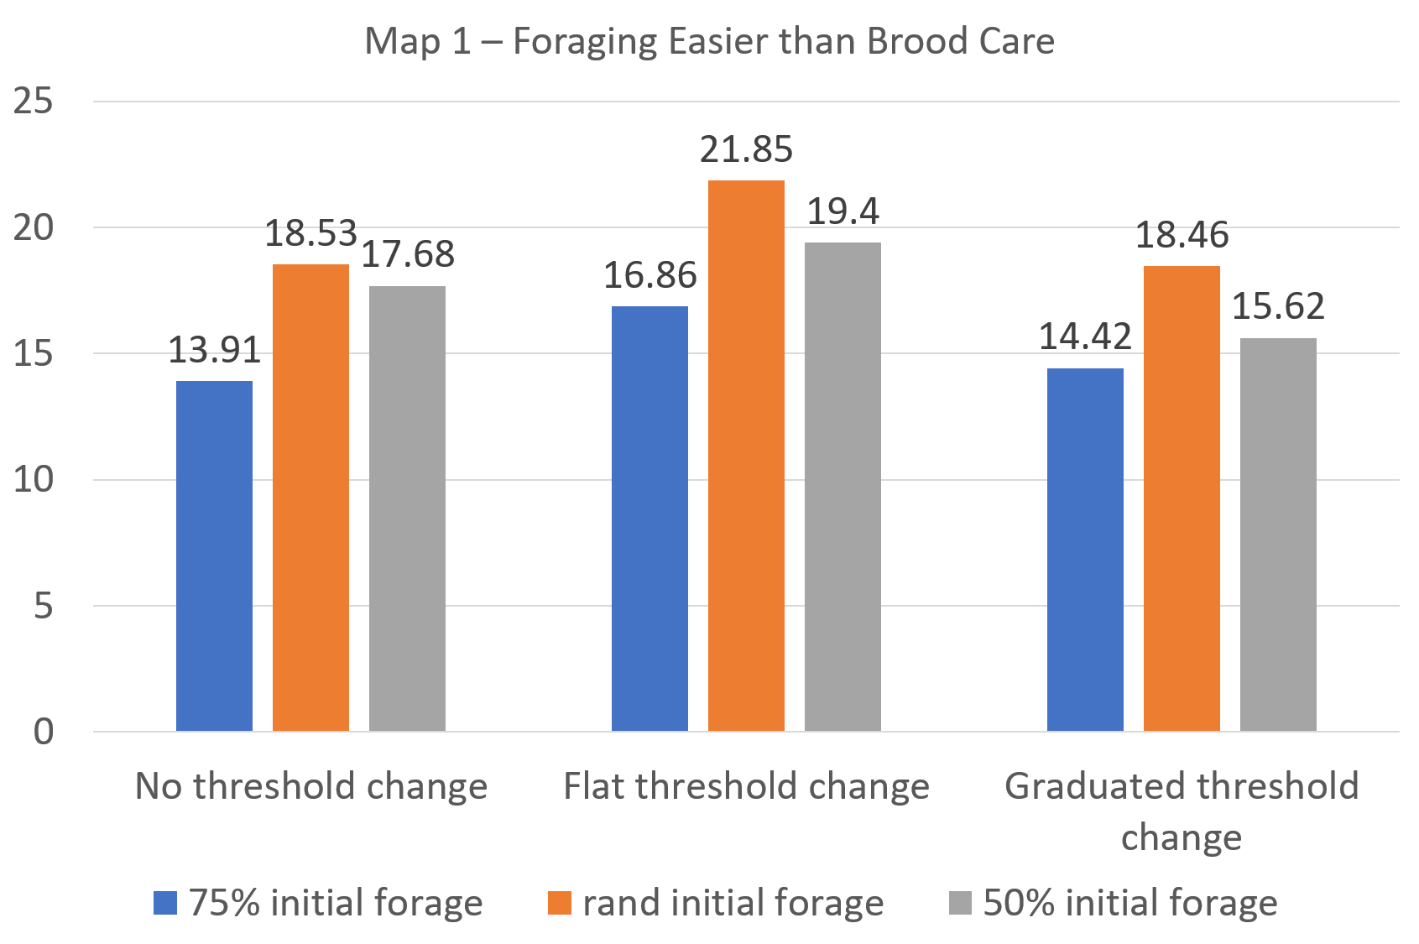
Notes:
Rand initialization and flat change did the best.
Rand initialization resulted in best performance for all change schemes.
Flat threshold change resulted in best performance, given a specific initialization method
In general, 50% initialization did better than 75% initialization.

Slide 5
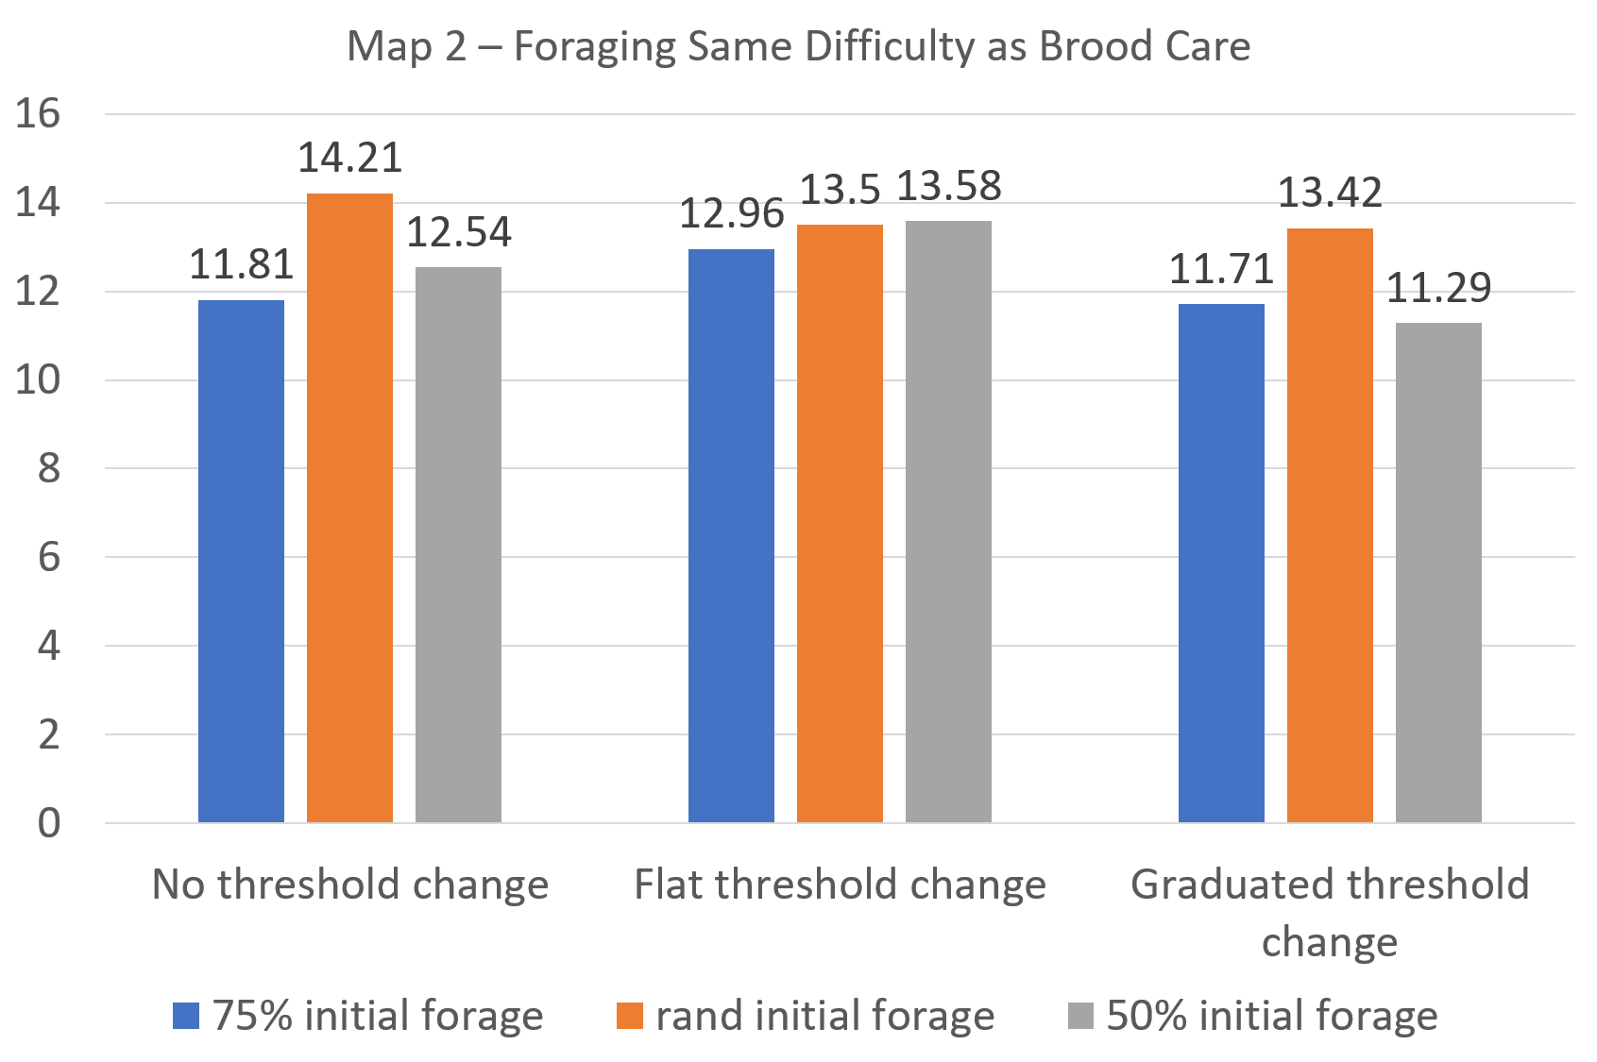
Notes:
Best performance by random initialization, no threshold change.
Given a threshold change scheme, random initialization seemed to help (except maybe for flat change).
However, flat change achieved 2nd and 3rd best performance. Given an initialization scheme, flat change did better except for random initialization.

Slide 6
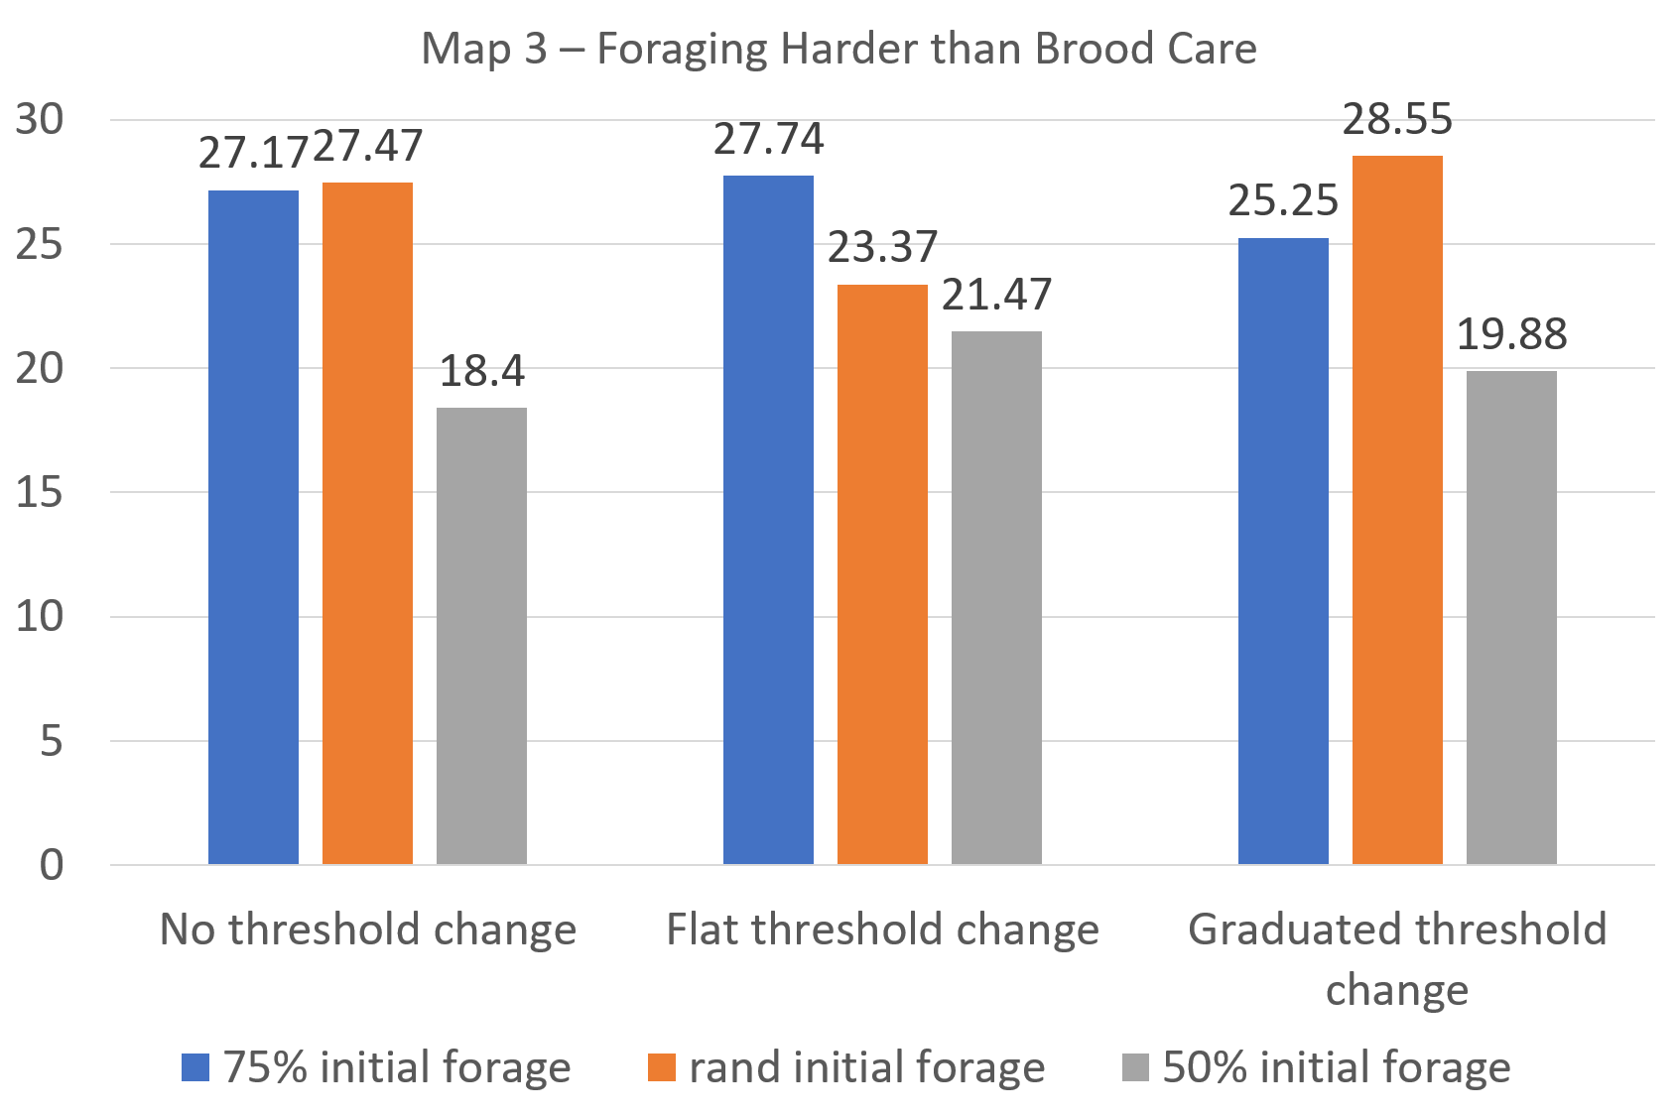
Notes:
Best performer was random initialization, graduated change.
75% initialization did better than 50% initialization. However, random initialization did comparably (except for flat change) - also surprising for no threshold change scheme.
Given an initialization scheme, flat change performed the best except for random initialization.
IMPORTANT: Random forces may make the above trends not hold. We didn’t run these simulations multiple times!

Slide 7
Observation and Conclusion
Random Initial Threshold with flat change rate is not highest always. (Hypothesis not confirmed)
Hypothesis only holds during easy foraging map (may be due to random favor to foragers)
Opposite to Hypothesis seen in harder foraging map (which confirms the favor to foragers)
A higher numbers of ants in the more difficult section of the map.
Reason: Longer unsuccessful wiggling
Equalizes points (brood/forage) while starting threshold 50% or Random
Graduated threshold change performs worse than Flat change
Reason: Less able to change side to perform better
Fallacy 1: Random threshold is too random (very high initial threshold possible)
Fallacy 2: Hard Forage map has wider lanes (giving more points)

Slide 8
Contribution
More ants gets assigned to more difficult tasks by simple adaptation.
Easier task gets finished early, hence need less labor
Without threshold change by experience, Initial Randomness generates more division of labor.
initial Threshold distribution plays the most vital role
Random threshold initialization gives most Ant-Points for No Threshold change.
Graduated Experience feedback performs worse than Flat Experience
Less change to get switched to high performance side.
More factors needed to be considered.
Random Initialization > Fixed Initialization
Flat Change Rate > Graduated Change Rate
But, these did not hold for Foraging-hard map.

Slide 9
Reference
Locher, G. D. A., Giannotti, E., & Tofolo, V. C. (2009). Brood care behavior in Ectatomma brunneum (hymenoptera, formicidae, ectatomminae) under laboratory conditions. Sociobiology, 54(2), 573–587.
Ravary, F., Lecoutey, E., Kaminski, G., Châline, N., & Jaisson, P. (2007). Individual Experience Alone Can Generate Lasting Division of Labor in Ants. Current Biology, 17(15), 1308–1312.

